Slide 1
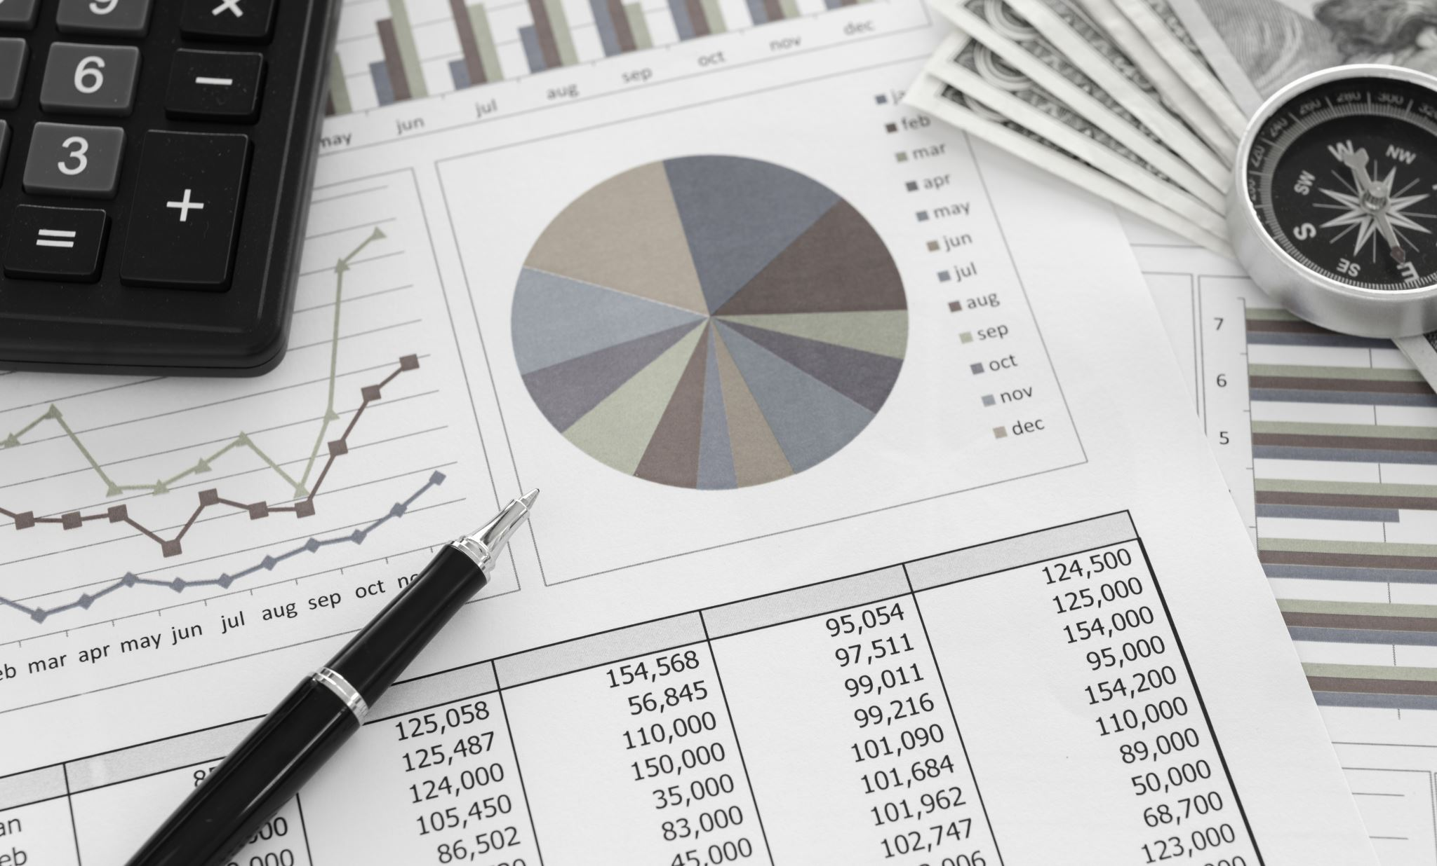
Car Price Prediction Analysis
By
Jayanthar S
DADS July - B

Slide 2
Dataset Overview
This dataset contains columns of year, brand, engine size, fuel type, transmission, millage, condition, price and model to make further analysis
This helps me to identify how the mileage, engine type varies from different brand, model to predict prices

Slide 3
Data Cleaning Process
Identified missing values
Removed duplicated
Verified data types
Corrected spelling of words
Splitting columns
Merging data

Slide 4
DAX Functions
Sum function is performed to identify the price patterns happened
Average function is performed to identify the average mileage of cars
Count distinct function is performed to identify the individual counts of brands
Count function is performed to identify the total counts of values
Maximum function is performed to identify the top most performing mileage cars

Slide 5
DAX Functions
Calculate function is performed to validate function to one specific category
Median function is performed to identify the middle value
If function is performed to identify the conditions whether true or false
Rank function is performed to list in order of ascending or descending
Top 5 performed to know the best performing cars

Slide 6
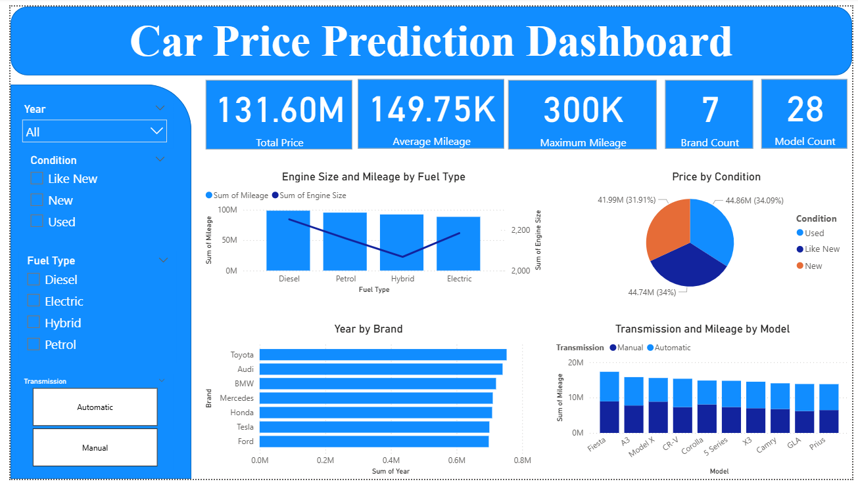
Dashboard Overview

Slide 7

Dashboard Overview
We have total count of brands of 7 and models of 28
In brands by year we have Toyota, Audi, BMW tops the list
In conditions by price we can have used cars has shared the higher collection comparing to others
In engine size and fuel type we have diesel cars shows the higher mileage and hybrid shows the least mileage
In model wise we have manual transmission shows the higher count comparing to automatic transmission

Slide 8
Key Insights
In transmission we can see more mileage on manual cars comparing to automatic cars. we can predict more car prices on that cars
In price by condition we can see used cars performs well comparing to new and like new cars. We can suggest to keep more used cars to predict higher price
In years by brand we can see Toyota tops and ford bottoms the list. Company can predict more Toyota cars with high price

Slide 9
Recommendations
We can improve the qualities of new and like new cars to predict car prices in future like old cars
We can build customer trust on brand which is lower performing from the list
We can try to improve the mileage for automatic cars like manual cars for better car price prediction in future

Slide 10
Conclusion
In this we identified the patterns to improve the features to improve the further fixing of price
Various trends on how the millage, engine size, fuel type is effective in fixing the price of cars
If it is dropping what are the possibilities to improve it in future occasions with the resources available

